Slide 1

Digital LOGIC DESIGN
Lecture-1
UNIT-vi
PROGRAMABLE LOGIC DEVICES
Archana P
BE(ECE), MTECH(ECE)
Dept of ECE

Slide 2
Review of Unit-5 : Sequential Circuits-II
The sequential circuit model.
Asynchronous counters
Design of simple synchronous sequential circuits such as counters.
Design of modulo-N counter, Ring counter, twisted ring counter.
Shift registers
Applications: Design of 1010 sequence detector

Slide 3
Unit-6: Programmable Logic Devices
Basic PLD’s-ROM, PROM, PLA, and PLD
Realization of Switching functions using PLDs.
Algorithmic State Machines: State machines and state diagrams.
Applications: Design of a Weighing machine and Binary multiplier.

Slide 4
Programmable Logic Devices
A Programmable Logic Device (PLD) is an integrated circuit with internal logic gates that are connected through electronic fuses.
The gates in a PLD are divided into an AND array and an OR array that are connected together to provide an AND-OR sum of product implementation.
The initial state of a PLD has all the fuses intact.
Programming the device involves the blowing of internal fuses to achieve a desired logic function.

Slide 5
ROM vs. PLA/PAL
Fixed
Programmable
Programmable
Inputs
AND array
Connections
OR array
Outputs
(decoder)
(a) Programmable read-only memory (PROM)
Inputs
Programmable
Programmable
Fixed
Connections
AND array
OR array
Outputs
(b) Programmable array logic (PAL) device
Programmable
Programmable
Programmable
Programmable
Inputs
Connections
AND array
Connections
OR array
Outputs
(c) Programmable logic array (PLA) device

Slide 6
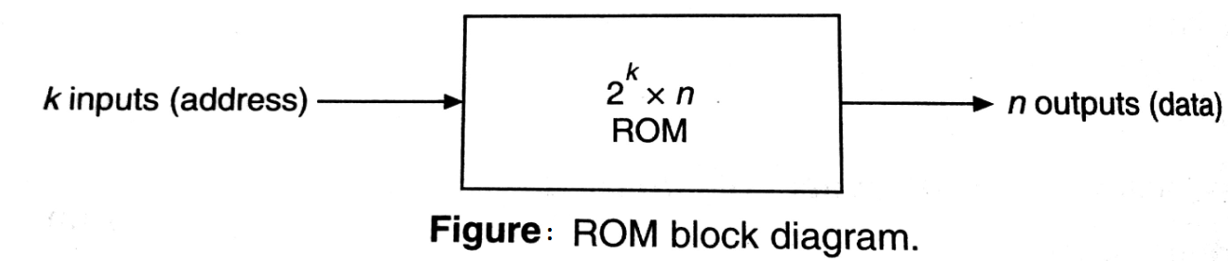
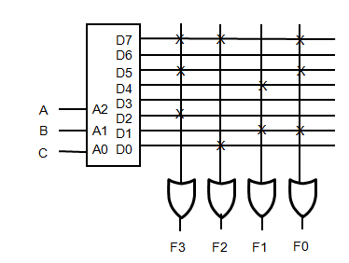
Read Only Memory(ROM)
Given a 2^{k}x n ROM, we can implement any combinational circuit with at most k inputs and at most n outputs.
k-to-2^{k} decoder will generate all 2^{k} possible minterms
Each of the OR gate implements SOP expression
AND gate array is fixed and OR gate array is programmable.
F0 = ∑ (1,5,7) F1= ∑ (1,4) F2= ∑ (0,7) F3= ∑ (2,5,7)

Slide 7
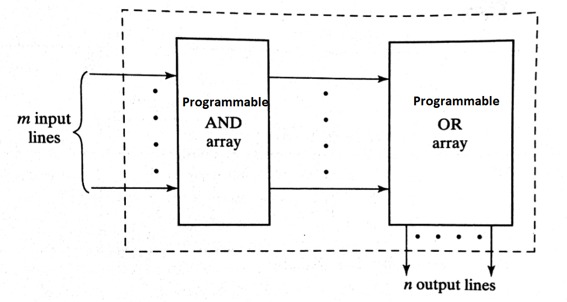
Programmable Logic Array(PLA)
AND gate array is programmable and OR gate array is also programmable
The PLA does not provide full decoding of the input variables and does not generate all the minterms. Generates minterms as per the problem requirement.
Product terms are generated by programmable AND array.
Sum Of Products is generated by programmable OR array.

Slide 8
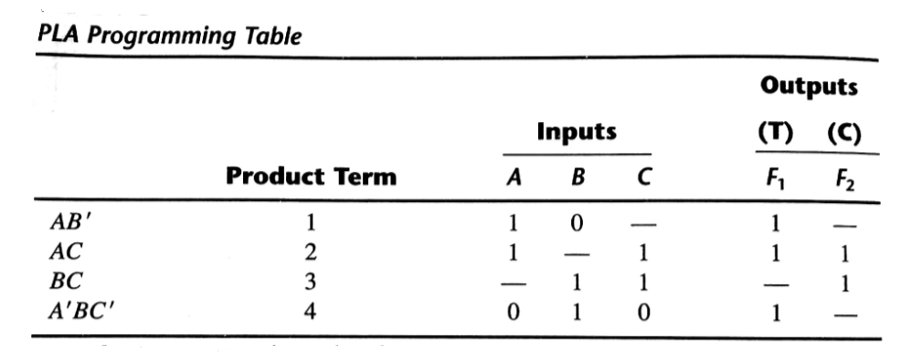
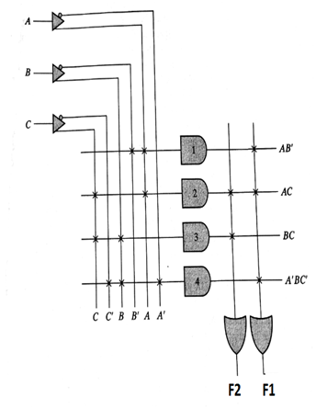
EX 1: Implement the given functions using PLA F1 = AB’ +AC+A’BC’ F2= AC+BC

Slide 9
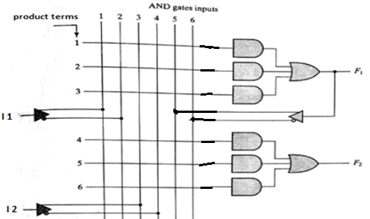
Programmable Array Logic (PAL)
The PAL is a programmable logic device with programmable AND array and fixed OR array.

Slide 10
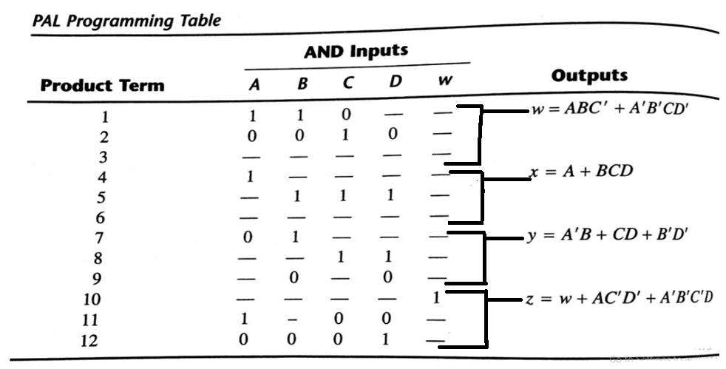
EX 1: implement given functions using PAL W= ABC’ +A’B’CD’ X= A+BCD,Y= A’B+CD+B’D’ , Z= ABC’+A’B’CD’+ AC’D’+ A’B’C’D
Programmable Array Logic (PAL)

Slide 11
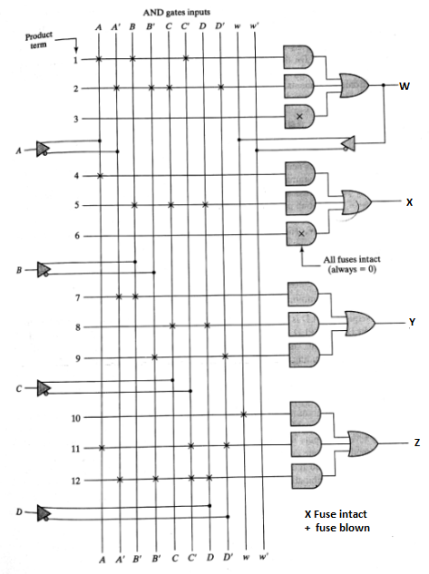
W= ABC’ +A’B’CD’
X= A+BCD
Y= A’B+CD+B’D’
Z= ABC’+A’B’CD’+ AC’D’+ A’B’C’D

Slide 12
ASM CHART
A special flow chart that specifically to define digital hardware algorithms is called ASM chart.
A hardware algorithm is a step by step procedure to implement the desire task
What is the Difference between conventional flow chart and ASM chart
conventional flow chart describes the sequence of procedural steps and decision paths for an algorithm with out concern for their time relationship
An ASM chart describes the sequence of events as well as the timing relationship b/n the states of sequential controller and the events that occur while going from one state to the next.

Slide 13
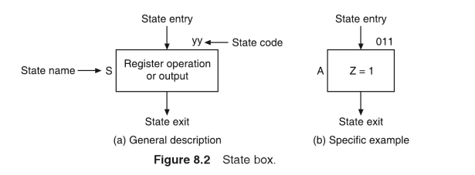
Components of ASM Chart
State box:
A state of a clocked sequential circuit is represented by a rectangle called state box.
The name of the state is written to the left of the box.
The binary code assigned to the state is indicated outside on the top right side of the box.
A list of unconditional outputs is written in the box.

Slide 14
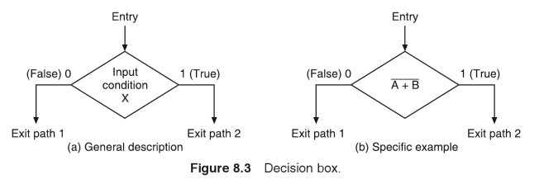
Components of ASM Chart
2. Decision box:
The decision box is represented by a diamond shape with one input path and two output paths.
The outputs are true and false paths.
The decision box describes the effect of an input on the control subsystem.
A Boolean variable or input or expression written inside the diamond indicates a condition which is evaluated to determine which branch to take..

Slide 15
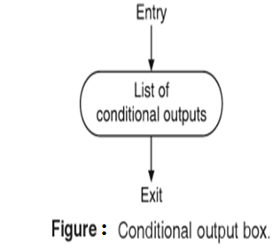
Components of ASM Chart
3.Conditional output box:
The conditional output box is represented by a n oval with one input path and one output path.
The outputs that depend on both the state of the system and the inputs are indicated inside the box.

Slide 16
Salient Features of ASM Chart
ASM chart describes the sequence of events as well as the timing relationship between the states.
ASM chart contains one or more interconnected blocks.
Each ASM block contains exactly one state box together with the decision boxes and conditional output boxes associated with that state.
Every block in an ASM chart specifies the operations that are to be performed during one common clock pulse.
ASM chart block has exactly one entrance path and one or more exit paths represented by the structure of the decision boxes.

Slide 17
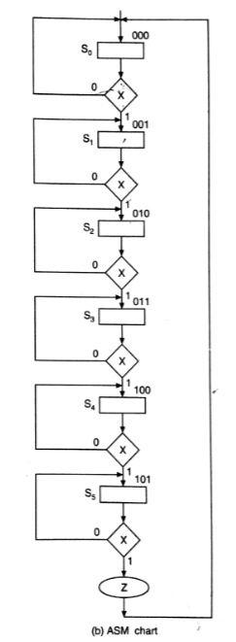
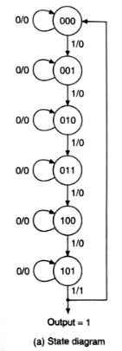
Example ASM chart for MOD-6 counter

Slide 18
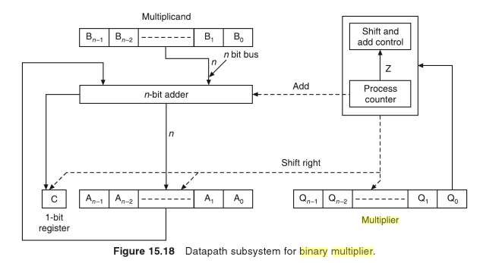
Binary Multiplier
Multiplication Operation Steps
Bit Q₀ of multiplier operand is checked.
If Q₀ bit is one then multiplicand and partial product are added and all bits of C, Aand Q registers are shifted to the right one bit.
If Q₀ bit is 0 then only shift operation is carried out.
Steps 1 and 2 are repeated n times to get the desired result in the A and Q registers.

Slide 19
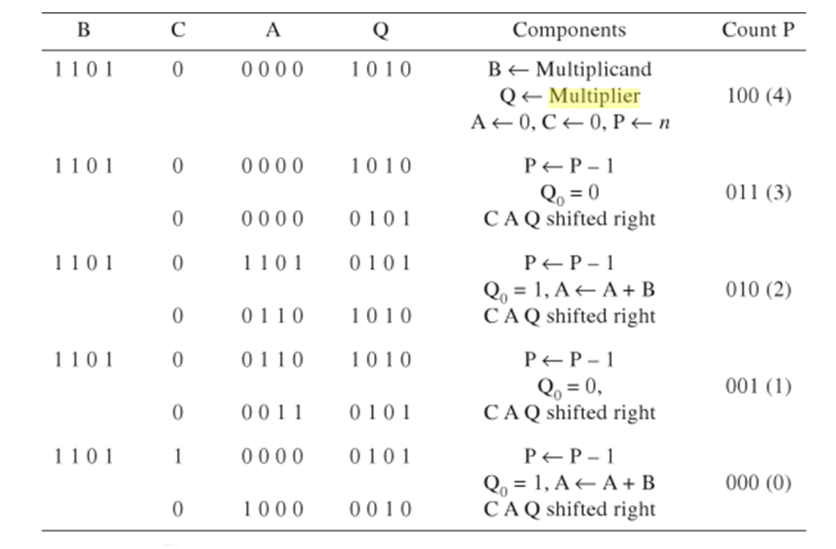
Example Multiplication Operation

Slide 20
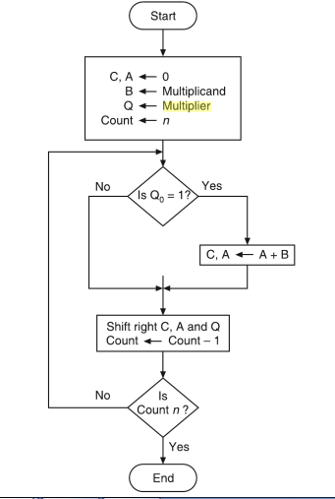
Flow Chart for Multiplier

Slide 21
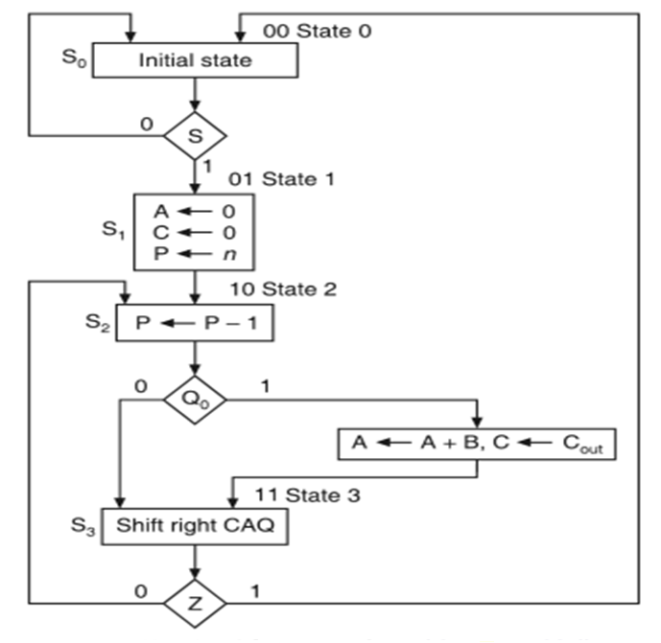
ASM Chart for Multiplier

Slide 22
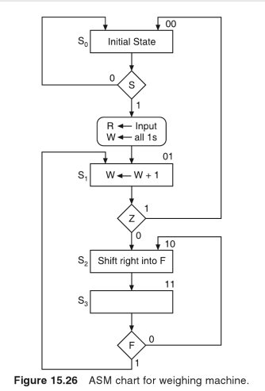
ASM Chart for Weighing Machine
We want to design a sequential machine which will calculate the weight of a given binary number.
The weight of a binary number is defined as the number of 1s present in its binary representation.

Slide 23
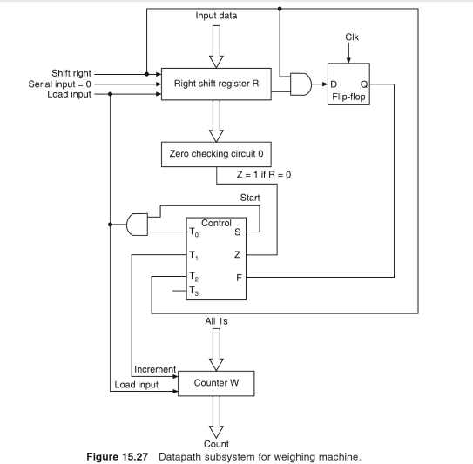

Slide 24
